Slide 1
BLOGGIFY
Twitter Without Limits.

Slide 2
About Bloggify
Bloggify is an online publishing platform. The platform is an example of social journalism, having a hybrid collection of amateur and professional people and publications, or exclusive blogs or publishers on Bloggify, and is regularly regarded as a blog host.
“Read and Write the Stories that Matters”

Slide 3
Features of Bloggify
Blog management
Dashboard: The dashboard is the primary tool for the typical Bloggify user. Through the dashboard, users are able to comment and clap posts.
Comments: User can share their views about the article.

Slide 4
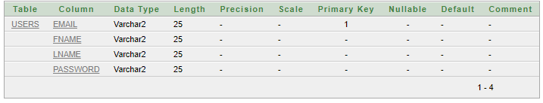
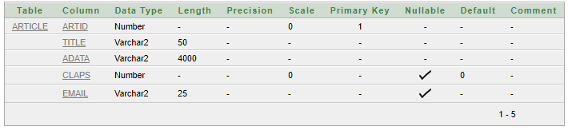
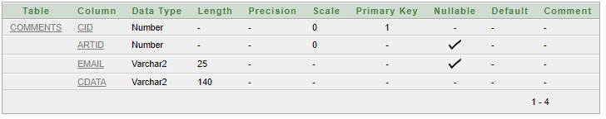
Database Description

Slide 5
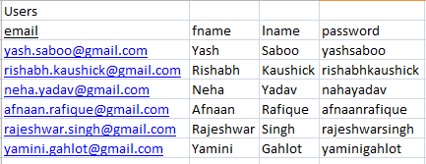
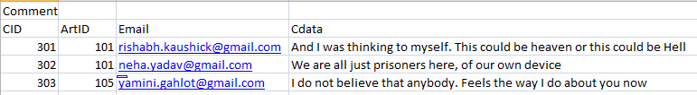
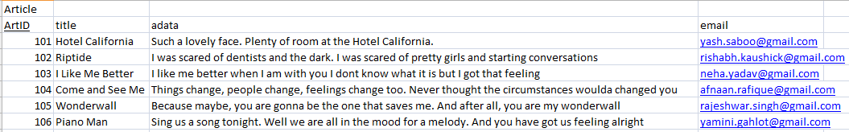
Dummy Database

Slide 6
Module 1: Registration
Allows to register new users. Without registering in the website, people will not be allowed access to the contents of the website.
This module will read the following input from the user:
Name
Email Address
Password
Assumption: user must have an email account.

Slide 7
Design Class for Registration
Controller: SignUpController
DAO: SignUpValidate
ISignUpValidate
DTO: User

Slide 8
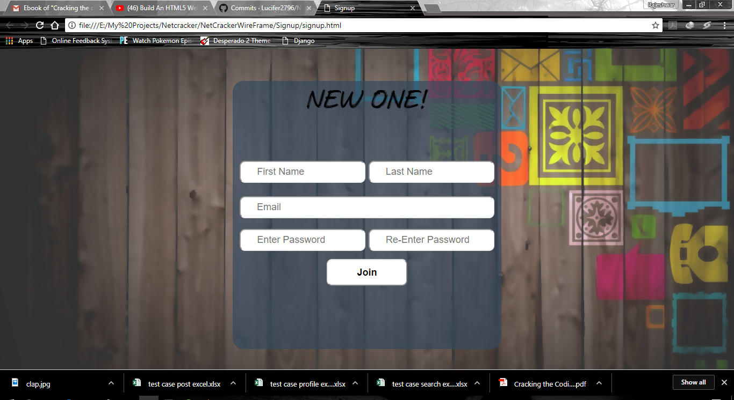

Slide 9
Module 2: Login
First webpage that would be displayed to the user
'Sign Up' button for unregistered Users.
Login credentials will be validated from the database from the 'User' table.

Slide 10
Design Class for Login
Controller: FrontController
DAO: LoginValidate
DTO: User

Slide 11
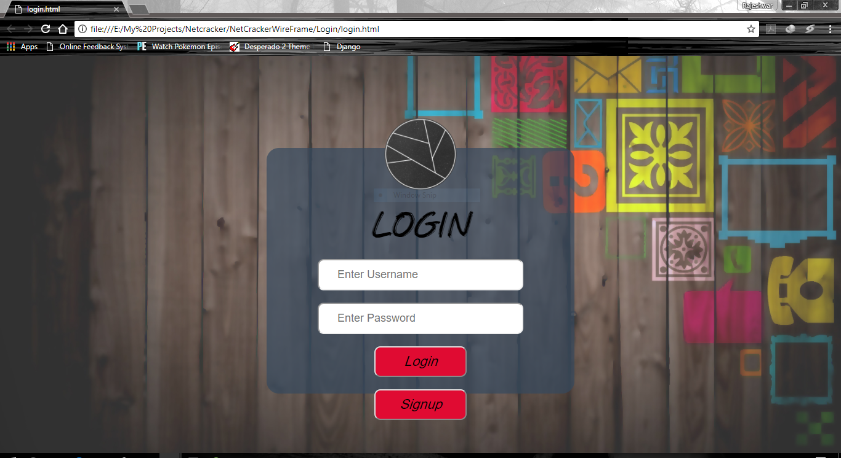

Slide 12
Module 3: Home Page
The first thing a user should see when logged in to a blogging website is Blogs!
Homepage is the first view of the web application when the user logs in. It will showcase multiple articles based on multiple domains that are viewable by all logged-in users. They will be retrieved from the database from the Article table shown below. It will also have the search and profile feature that can be used when needed.

Slide 13
Design Class for Home Page
Controller: FrontController
DTO: User
DAO: ArticleList
IArticleList
Service: ArticleService

Slide 14
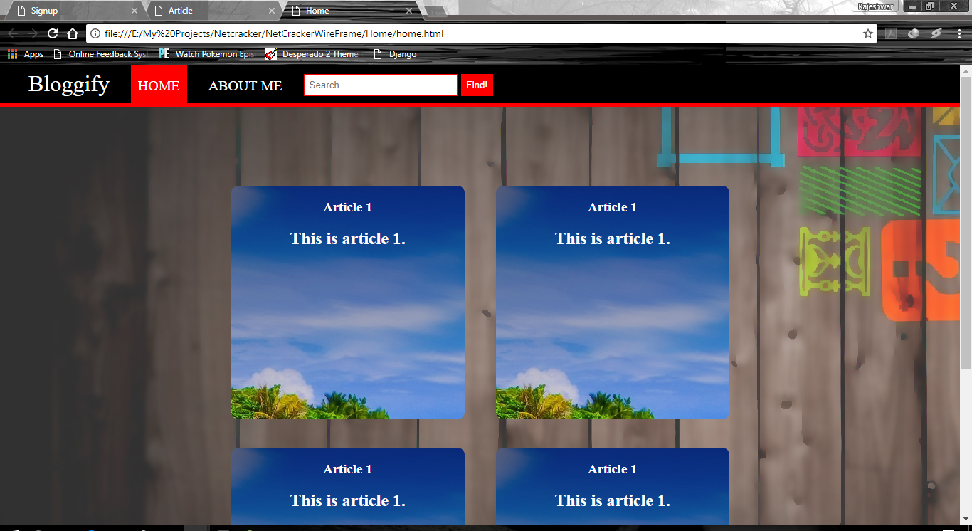

Slide 15
Module 4: Profile
User’s Basic Information is displayed.
Provides option to add an article under that profile.

Slide 16
Design Class for Profile
Controller: FrontController
DTO: User
DAO: UserData
IUserData
Service: UserDataService

Slide 17
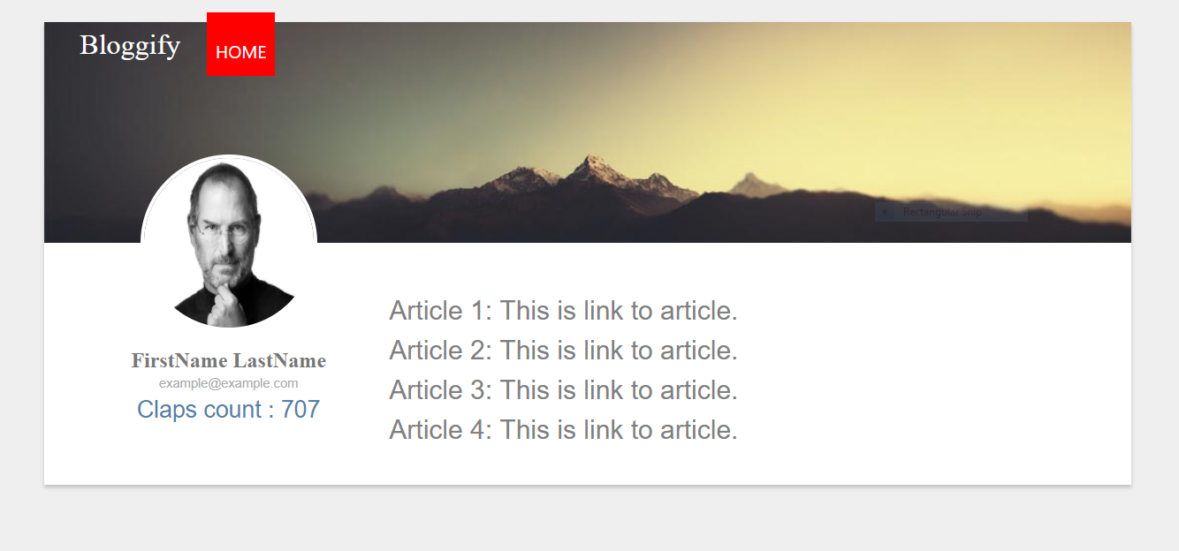

Slide 18
Module 5: Post
To post a new article
Implements tagging behavior by providing functionality to all registered users to post articles under provided categories (one category at max).
These articles are entered into the database category wise and accessed when another user attempts to search them through the search module.

Slide 19
Design Class for Post
Controller: FrontController
DTO: User
DAO: NewPost
INewPost
Service: NewPostService

Slide 20
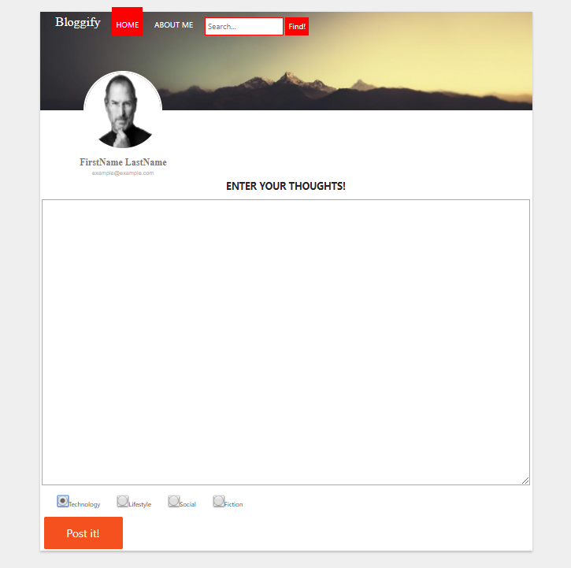

Slide 21
Module 6: Blog and Comments
Lets you view the article.
Also lets the user comment on the article.

Slide 22
Design Class for Blog and Comments
Controller: FrontController
DTO: User
DAO: CommentDAO
CommentList
ViewArticle
IViewArticle
Service: ViewArticleService

Slide 23
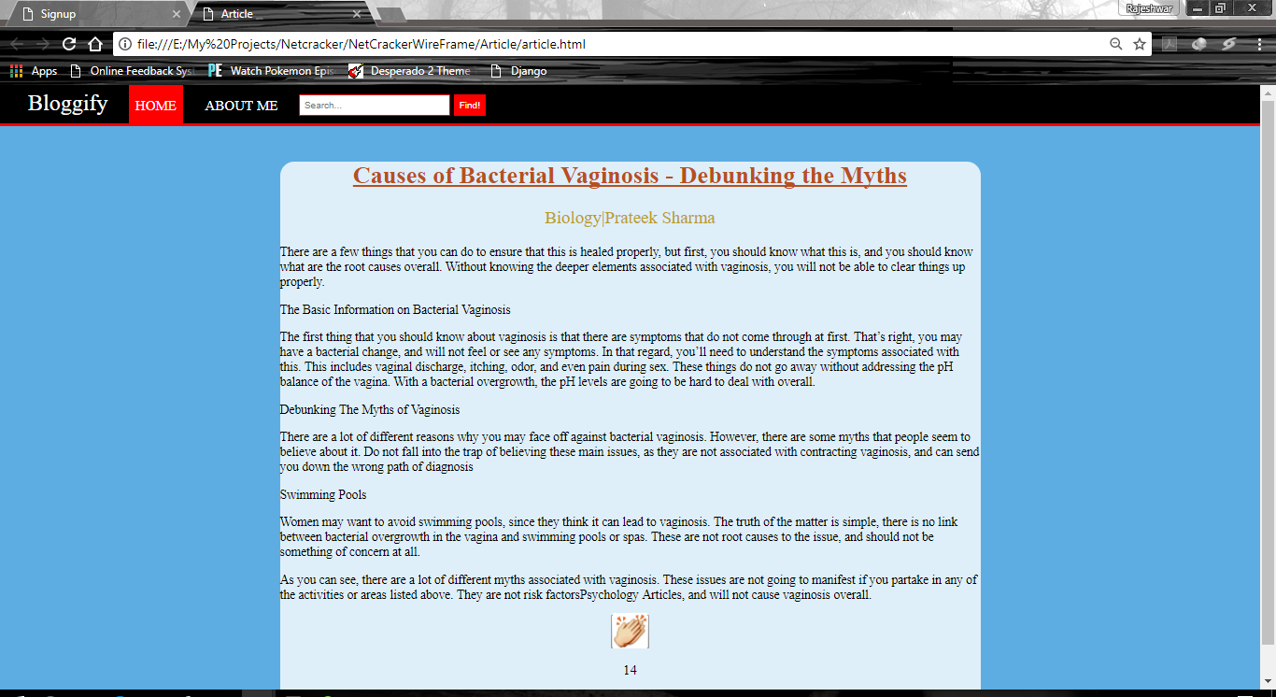

Slide 24
Future Scope
Searching articles
Clapping at Articles to show appreciation
Sorting articles based on tags
Reply to Comment
Login and Connecting to Social Media
Tags
Using Machine Learning to recommend similar articles

